Slide 1

Cloud Databases

Slide 2
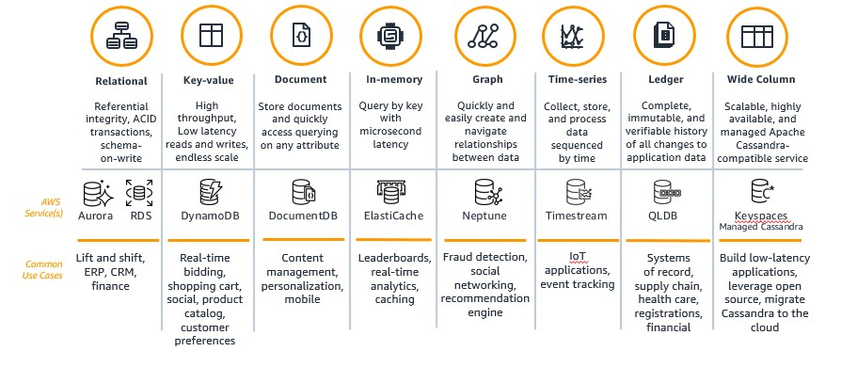
AWS Database Services

Slide 3
AWS Database Services

Slide 4



Managed vs Unmanaged Service
Unmanaged:
Scaling, fault tolerance, and availability are managed by you.
Managed:
Scaling, fault tolerance, and availability are typically built in to the service managed by AWS.
Picture source by Istock

Slide 5

Database Services Overview
Database in Amazon Elastic Compute Cloud (Amazon EC2)
Database in Amazon RDS or Amazon Aurora
On-premises database
Application optimization
Scaling
High Availability
Database backups
Database software patches
Database software installs
Operation system patches
Operating system install
Server maintenance
Rack and stack servers
Power, HVAC, network
Application optimization
Scaling
High Availability
Database backups
Database software patches
Database software installs
Operation system patches
Operating system install
Server maintenance
Rack and stack servers
Power, HVAC, network
Application optimization
Scaling
High Availability
Database backups
Database software patches
Database software installs
Operation system patches
Operating system install
Server maintenance
Rack and stack servers
Power, HVAC, network
AWS
provides
AWS
provides

Slide 6
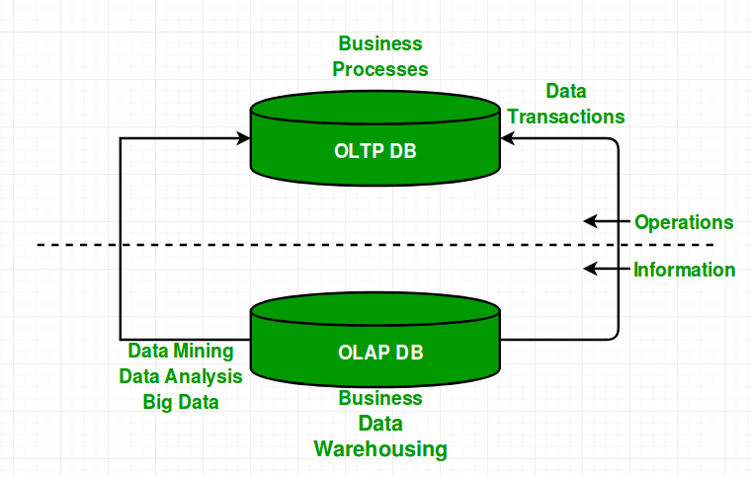
OLTP vs OLAP
OLTP is an Online Transaction Processing system. The main focus of OLTP system is to record the current Update, Insertion and Deletion while transaction. The OLTP queries are simpler and short and hence require less time in processing, and also requires less space.
OLAP is an Online Analytical Processing system. OLAP database stores historical data that has been inputted by OLTP. It allows a user to view different summaries of multi-dimensional data. Using OLAP, you can extract information from a large database and analyze it for decision making.

Slide 7
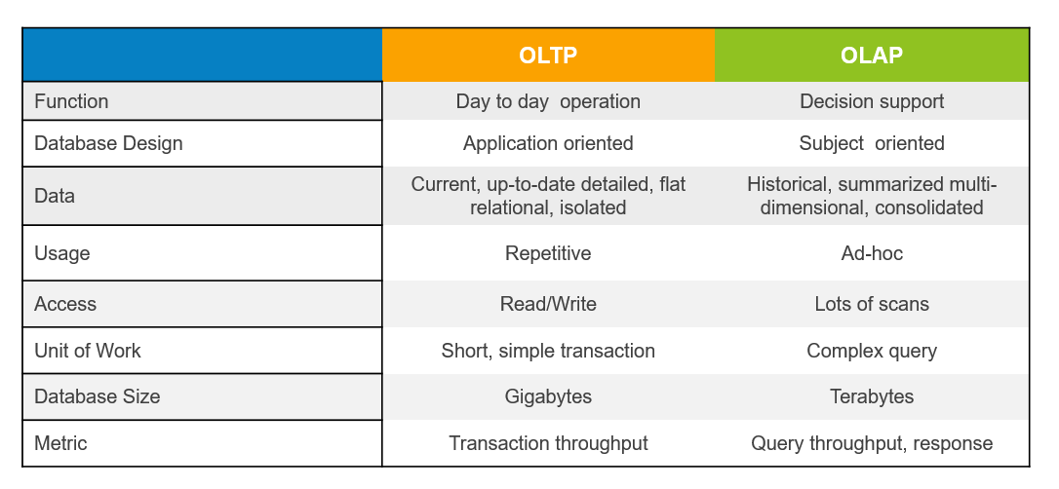
OLTP vs OLAP

Slide 8
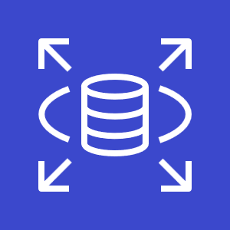
AWS RDS
Amazon Relational Database Service (Amazon RDS) is a managed service that makes it easy to set up, operate and scale a relational database in the cloud.
Relational databases are known as Structured Query Language (SQL) databases.
Non-relational databases are known as NoSQL databases.
RDS is an Online Transaction Processing (OLTP) type of database
Amazon RDS supports the following database engines:
• SQL Server
• Oracle
• MySQL Server
• PostgreSQL
• Aurora
• MariaDB
RDS features and benefits:
• SQL type of database
• Can be used to perform complex queries and joins
• Easy to setup, highly available, fault tolerant and scalable
• Used when data is clearly defined
• Common use cases include online stores and banking systems

Slide 9
AWS RDS
RDS features and benefits:
• SQL type of database
• Can be used to perform complex queries and joins
• Easy to setup, highly available, fault tolerant and scalable
• Used when data is clearly defined
• Common use cases include online stores and banking systems
Encryption:
• You can encrypt your Amazon RDS instances and snapshots at rest by enabling the encryption option for your Amazon RDS DB instance.
• Encryption at rest is supported for all DB types and uses AWS KMS.
• You cannot encrypt an existing DB. You need to create a snapshot, copy it, encrypt the copy, then build an encrypted DB from the snapshot.

Slide 10
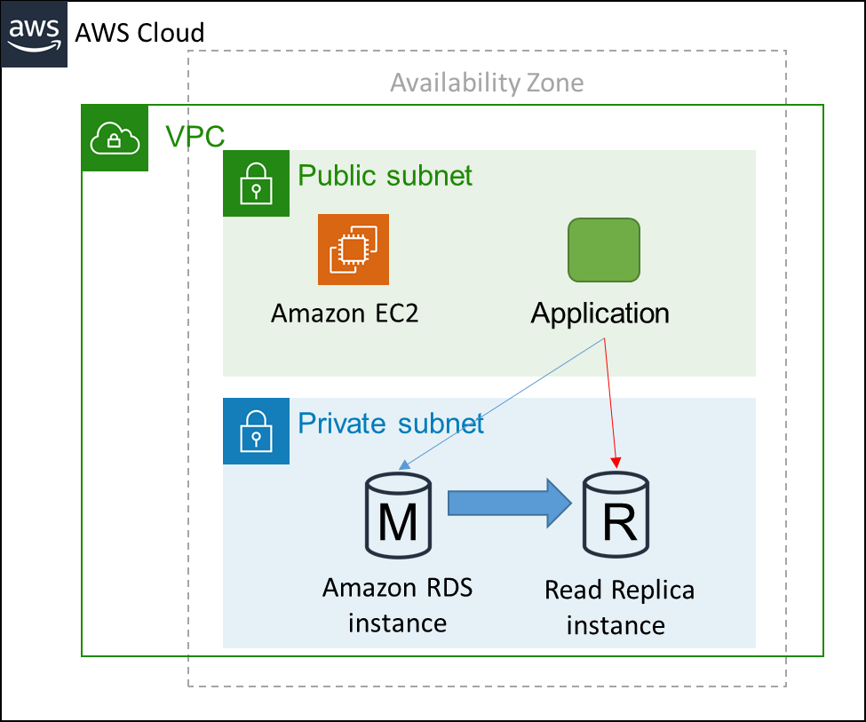
Amazon RDS read replicas
Offers asynchronous replication
Can be promoted to master if needed
provide improved performance for reads:
Read replicas are used for read heavy DBs and replication is asynchronous.
Read replicas are for workload sharing and offloading.
Read replicas provide read-only DR.
Read replicas are created from a snapshot of the master instance.
Must have automated backups enabled on the primary (retention period > 0).
Scalability:
You can only scale RDS up (compute and storage)
You cannot decrease the allocated storage for an RDS instance
You can scale storage and change the storage type for all DB engines except MS SQL
DB should be in Private subnet
Notes:
Amazon RDS also supports the creation of read replicas for MySQL, MariaDB, PostgreSQL, and Amazon Aurora. Updates that are made to the source database instance are asynchronously copied to the read replica instance. You can reduce the load on your source database instance by routing read queries from your applications to the read replica. Using read replicas, you can also scale out beyond the capacity constraints of a single database instance for read-heavy database workloads. Read replicas can also be promoted to become the master database instance, but this requires manual action because of asynchronous replication.
Read replicas can be created in a different Region than the master database. This feature can help satisfy disaster recovery requirements or reduce latency by directing reads to a read replica that is closer to the user.

Slide 11
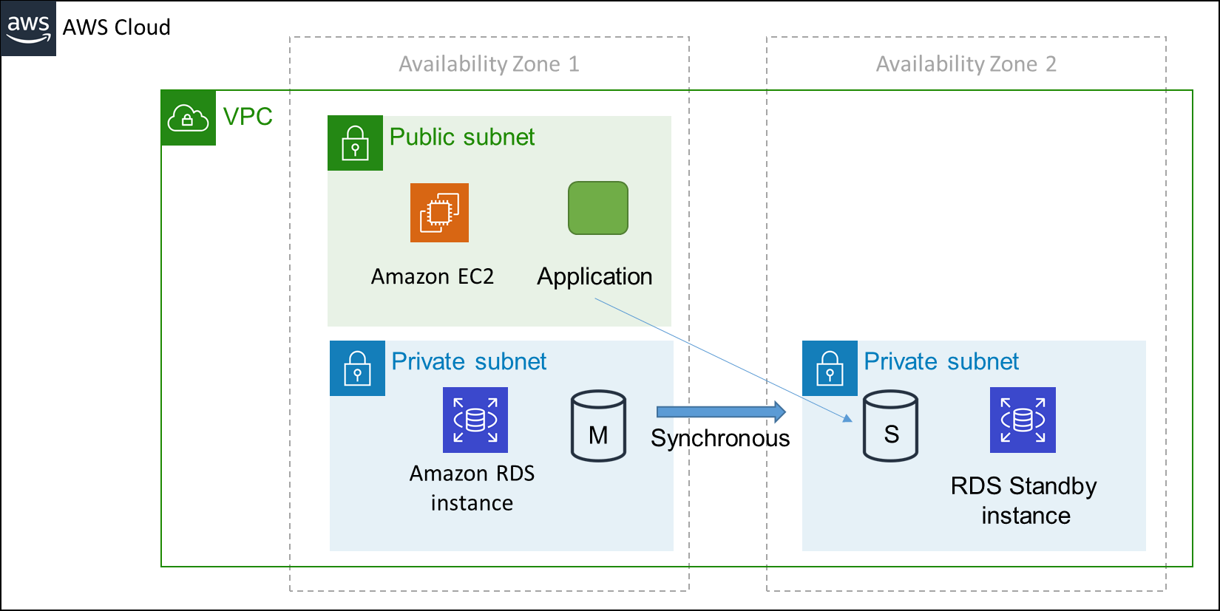
High availability with Multi-AZ RDS deployment
Notes:
Multi-AZ deployments can have one standby or two standby DB instances. When the deployment has one standby DB instance, it's called a Multi-AZ DB instance deployment. A Multi-AZ DB instance deployment has one standby DB instance that provides failover support, but doesn't serve read traffic. When the deployment has two standby DB instances, it's called a Multi-AZ DB cluster deployment. A Multi-AZ DB cluster deployment has standby DB instances that provide failover support and can also serve read traffic

Slide 12
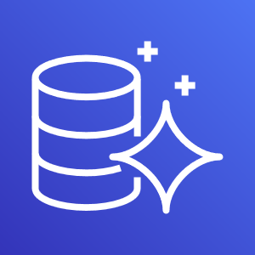
Amazon Aurora
Amazon Aurora is a fully managed, MySQL- and PostgreSQL-compatible, relational database engine.
Used for online transactional processing (OLTP)
Faster then MySQL and PostgreSQL
Replicates data six ways across three Availability Zones
Requires little change to your existing application
Amazon Aurora automatically increases the size of your database volume as your storage needs grow.
DB Snapshots are user-initiated backups of your instance stored in Amazon S3 that will be kept until you explicitly delete them
Amazon Aurora
Notes:
Fault-Tolerant and Self-Healing Storage because Each 10 GB chunk of your database volume is replicated six ways, across three Availability Zones.

Slide 13
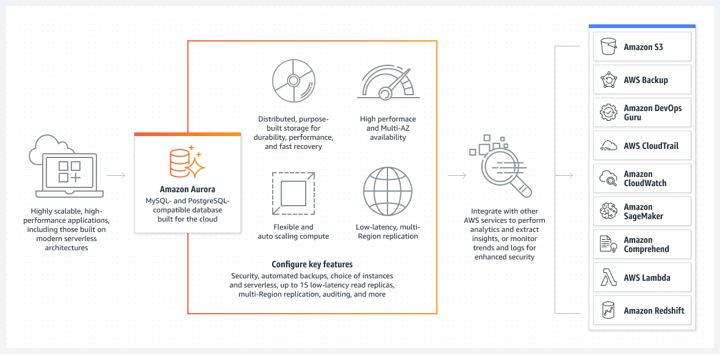
Amazon Aurora
Notes:
Amazon Aurora provides built-in security, continuous backups, serverless compute, up to 15 read replicas, automated multi-Region replication, and integrations with other AWS services.
Amazon Aurora Global Database is designed for globally distributed applications, allowing a single Amazon Aurora database to span multiple AWS Regions. It replicates your data with no impact on database performance, enables fast local reads with low latency in each Region, and provides disaster recovery from Region-wide outages.

Slide 14
Amazon RDS Pricing
DB instance type hours (partial hours are charged as full hours)
Engine
Size
Memory class
DB purchase type
On-Demand Instances : Compute capacity by the hour
Reserved Instances : Low, one-time, upfront payment for database instances that are reserved with a 1-year or 3-year term
Deployment type :Storage and I/0 charges vary, depending on whether you deploy to
Single Availability Zone
Multiple Availability Zones
Number of DB instances : Provision multiple DB instances to handle peak loads
Storage GB/month
I/O requests/month: The number of input and output requests that are made to the database
Provisioned IOPS/month – for RDS provisioned IOPS SSD
Egress data transfer
Backup storage (DB backups and manual snapshots usually S3 standard price)

Slide 15
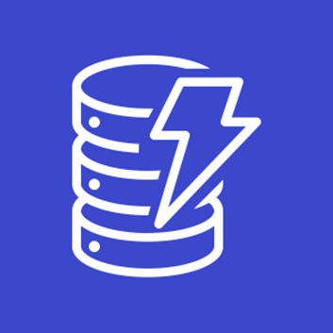
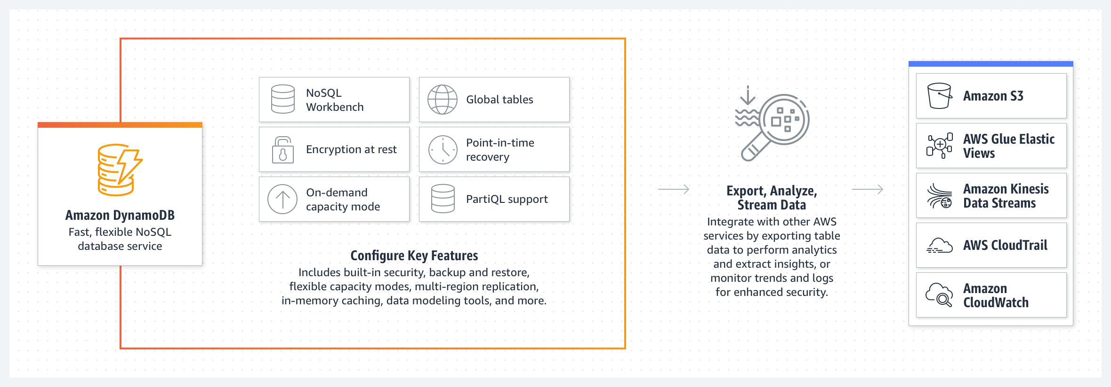
Amazon DynamoDB
Amazon DynamoDB is a fully managed NoSQL database service that provides fast and predictable performance with seamless scalability.
Dynamo DB features and benefits:
NoSQL type of database (non-relational)
Fast, highly available, and fully managed
Used when data is fluid and can change
Common use cases include social networks and web analytics

Slide 16
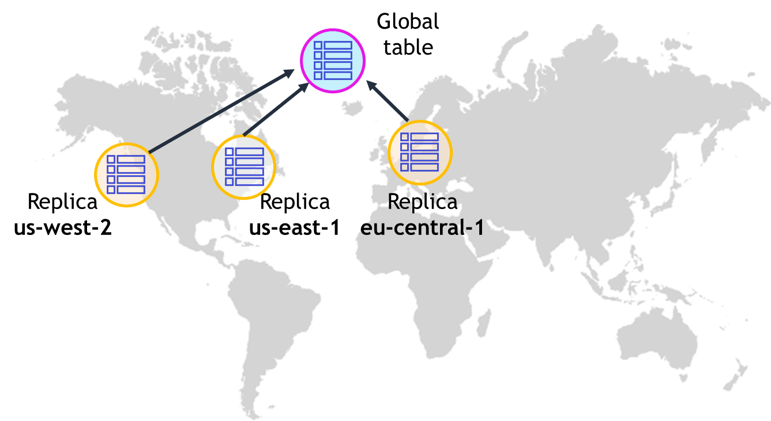
Amazon DynamoDB
Data is synchronously replicated across 3 facilities (AZs) in a region.
Cross-region replication allows you to replicate across regions:
Amazon DynamoDB global tables provides a fully managed solution for deploying a multi-region, multi-master database.
When you create a global table, you specify the AWS regions where you want the table to be available.
DynamoDB performs all of the necessary tasks to create identical tables in these regions and propagate ongoing data changes to all of them.
Provides low read and write latency.
Scale storage and throughput up or down as needed without code changes or downtime.
DynamoDB is schema-less.
DynamoDB can be used for storing session state.
Global tables provide a multi-region, multi-master database
Notes:
By default, Amazon DynamoDB replicates your data across multiple Availability Zones in a single Region. However, there might be occasions when you want to replicate your data across multiple Regions.
Amazon DynamoDB global tables provide a fully managed solution for deploying a multi-region, multi-master database. You do not need to build and maintain your own replication solution. When you create a global table, you specify the AWS Regions where you want the table to be available. DynamoDB performs all of the necessary tasks to create identical tables in these Regions. DynamoDB then propagates ongoing data changes to all the tables.

Slide 17

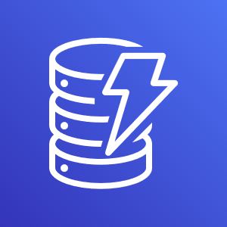

Amazon DynamoDB
Provides two read models:
Eventually consistent
Strongly consistent
Replica
Replica
Replica
Replica
Replica
Replica
The default setting. All copies of data usually reach consistency within 1 second.
This feature is optional. Use for applications that require all reads to return a result that reflects all writes before the read.

Slide 18
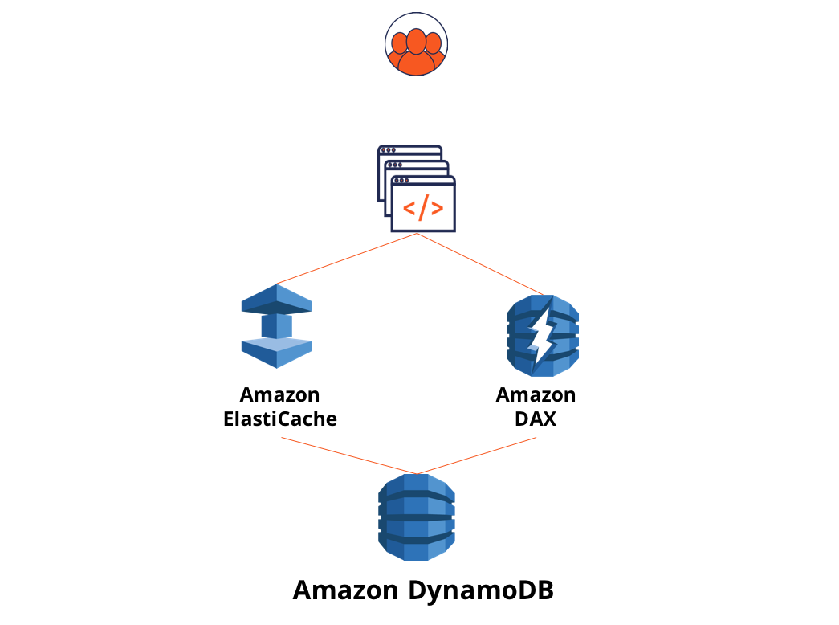
Amazon DynamoDB
Amazon DynamoDB Accelerator (DAX) is a fully managed, highly available, in-memory cache for DynamoDB that delivers up to a 10x performance improvement – from milliseconds to microseconds – even at millions of requests per second.

Slide 19
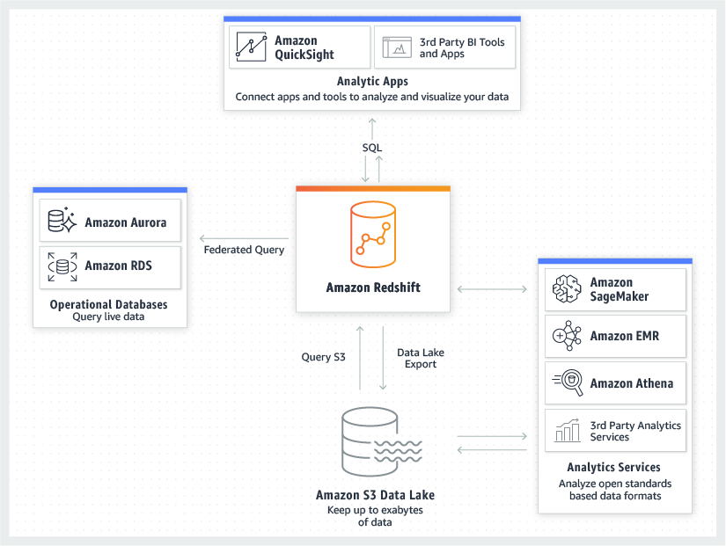
Amazon Redshift
Amazon Redshift is a fast, fully managed data warehouse that makes it simple and cost-effective to analyze all your data using standard SQL and existing Business Intelligence (BI) tools.
RedShift is a SQL based data warehouse used for analytics applications for big data
RedShift is a relational database that is used for Online Analytics Processing (OLAP) use cases.
RedShift is used for running complex analytic queries against petabytes of structured data, using sophisticated query optimization, columnar storage on high-performance local disks, and massively parallel query execution.
RedShift is 10x faster than a traditional SQL DB.
RedShift provides fault tolerance for the following failures:
Disk failures
Nodes failures
Network failure
AZ/region level disasters

Slide 20
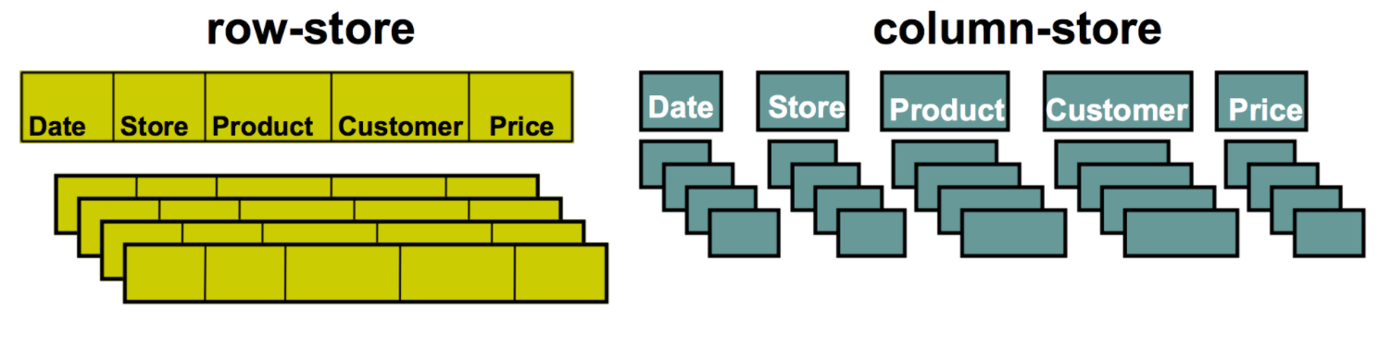
Amazon Redshift
RedShift uses columnar data storage:
Data is stored sequentially in columns instead of rows.
Columnar based DB is ideal for data warehousing and analytics.
Requires fewer I/O s which greatly enhances performance.
RedShift provides advanced compression
Data is stored sequentially in columns which allows for much better performance and less storage space.
RedShift automatically selects the compression scheme.
RedShift uses replication and continuous backups to enhance availability and improve durability and can automatically recover from component and node failures.
RedShift always keeps three copies of your data: The original A replica on compute nodes (within the cluster) A backup copy on S3 | RedShift provides continuous/incremental backups: Multiple copies within a cluster Continuous and incremental backups to S3 Continuous and incremental backups across regions Streaming restore

Slide 21
Amazon ElastiCache
ElastiCache is a web service that makes it easy to deploy and run Memcached or Redis protocol-compliant server nodes in the cloud.
The in-memory caching provided by ElastiCache can be used to significantly improve latency and throughput for many read-heavy application workloads or compute-intensive workloads.
Best for scenarios where the DB load is based on Online Analytics Processing (OLAP) transactions
Elasticache EC2 nodes cannot be accessed from the Internet, nor can they be accessed by EC2 instances in other VPCs.
Can be on-demand or reserved instances too (but not Spot instances).
Elasticache can be used for storing session state.
There are two types of ElastiCache engine:
Memcached – simplest model, can run large nodes with multiple cores/threads, can be scaled in and out, can cache objects such as DBs.
Redis – complex model, supports encryption, master / slave replication, cross AZ (HA), automatic failover and backup/restore.

Slide 22
Amazon ElastiCache use cases

Slide 23
Questions ?

